Slide 1
Secure Data hiding in images using Steganography
CAPSTONE PROJECT
Presented By:
Purusharth Pachauri
Raja Balwant Singh Engineering Technical Campus Agra
(Computer Science and Engineering)

Slide 2
OUTLINE
Problem Statement
Technology used
Wow factor
End users
Result
Conclusion
Git-hub Link
Future scope

Slide 3
Problem Statement
In the digital era, sensitive information often requires secure transmission methods to prevent unauthorized access and tampering.
Traditional encryption can draw attention to the presence of confidential data.
Steganography offers a solution by embedding secret information within benign media files (images, audio, etc.) without arousing suspicion.
The challenge is to develop robust steganographic techniques that ensure both high imperceptibility and resistance to detection, while maintaining the quality of the host media.

Slide 4
Technology used
Python,
Vs code,
Windows 11,
Cv2 library,
Ryzen 7, 16gb of ram, 512gb ssd,

Slide 5
Wow factors
Invisible Communication,
Versatile Mediums,
Historical Roots,
Technological Innovation,
Creative Applications.

Slide 6
End users
Journalists and Activists,
Government Agencies and Military,
Businesses and Corporations,
Researchers and Academia,
Everyday Internet Users.

Slide 7
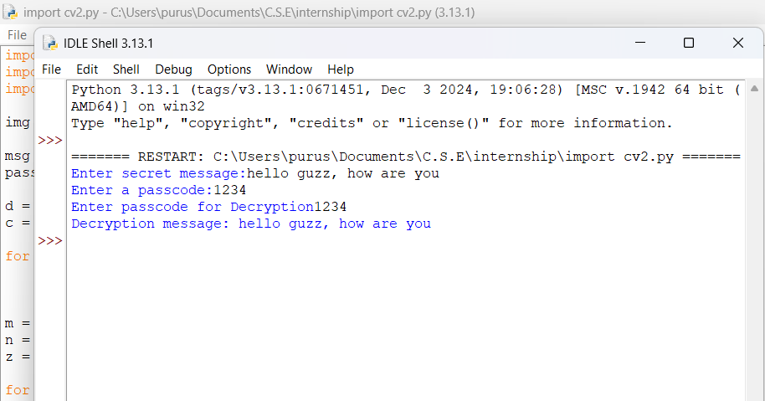
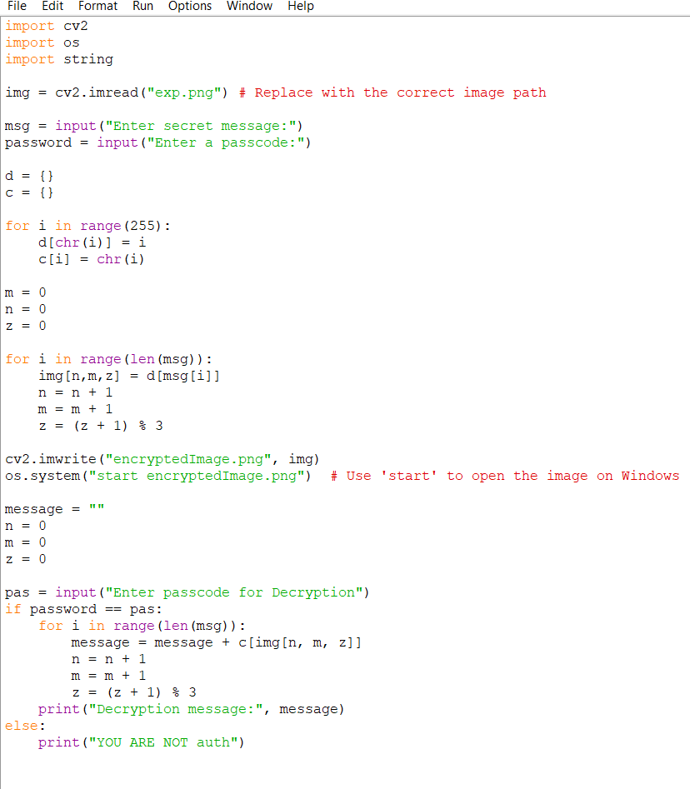

Results

Slide 8
Conclusion
Steganography is a critical tool for data security that provides an innovative solution to secret communication and information hiding. Through the process of hiding messages in plain sight in typical media files, it guarantees that sensitive data goes unnoticed and is protected. The versatility of steganography in all mediums—images, audio, and video—shows that it is highly versatile and applicable to the modern world. With every advancement in technology, more powerful steganographic techniques will develop, increasing its strength and usage, rendering it an unavoidable method for privacy and confidentiality protection in today's age.

Slide 9
GitHub Link
https://github.com/Purusharth-pachauri/internship.git

Slide 10
Future scope:
Advanced Algorithms,
Quantum Computing,
Artificial Intelligence,
Blockchain Integration,
Augmented Reality (AR) and Virtual Reality (VR).

Slide 11
THANK YOU

